Slide 1
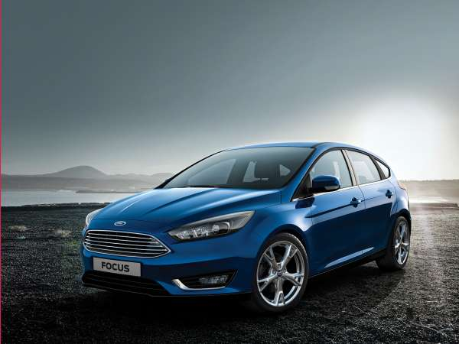
2015 ford focus
<img class="full-width" typeof="foaf:Image" width="600" height="450" alt="" src="http://www.popsci.com/sites/popsci.com/files/styles/medium_1x_/public/speed-lab-ford-focus.jpg?itok=VyU1XpNP" />2015 Ford Focus
Courtesy Ford
Engine: 3 or 4 cylinder Horsepower: 123 or 160 Fuel: Economy up to 27 city, 37 highway Price: $17,170
There’s nothing quite like the sinking feeling you get when a car starts to skid. First comes the realization that your vehicle is not going where you want. Then, panic, as you desperately try to remember that driver’s ed course (are you under- or over-steering?). Hopefully, you lay off the gas and brakes, and steer into the skid. Or you could use Ford’s new Enhanced Transitional Stability System (ETS).
Available in the 2015 Ford Focus, ETS predicts skids before they start. The system monitors a car’s speed, steering wheel, and how a driver is turning, and it calculates the likelihood of a skid. If a loss of traction appears imminent, electronic stability control kicks in. While ETS is currently available in just one model, it’s only a matter of time before Ford integrates it into others--and before competitors start doing the same. After all, a safer car is something that just about any driver would welcome.
Other Car News You Should Care About
Single-speed EV transmissions will give way to two-speed units within 5 to 6 years, according to German supplier ZF. As with gas-powered cars, adding more gears to electric motors will make them more efficient, extending their range by up to 20 percent.
The Environmental Protection Agency is proposing to reduce the federal ozone standard for cars, power plants, and oil refineries from 75 parts per billion to between 65 and 70--a move it calculates will prevent between 710 and 4,700 premature deaths per year by 2025.
From January through November 2014, the average fuel economy for new light vehicles sold in the United States was 25.1 miles per gallon, according to trade publication Wards Auto. That represents a year-over-year increase of 1.8 percent, the first in four years.
Alcoa, the U.S. aluminum group, developed a new manufacturing process that makes it easier to create lightweight aluminum body panels for vehicles. The process changes the metal at the molecular level, making it 40 percent more formable.
13: The number of hydrogen fueling stations in the United States. That number is projected to increase to 50 by 2017 as automakers work to bring fuel-cell vehicles to market.
Design Of The Month: The Audi Prologue Concept

Slide 2
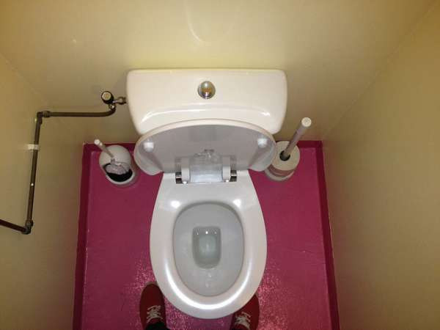
Earlier this week, a British Airlines flight from London to Dubai had to turn around after just 30 minutes in the air. It wasn’t because of a terrorist threat or weather or mechanical trouble. It was because someone on the plane left a really stinky poop in the airplane bathroom. And while that’s probably very unpleasant, it doesn’t actually pose much risk for transmitting disease.
There are a lot of different reasons why stool might smell particularly foul, and it doesn’t always mean the pooper is sick. Medication or too much of a particular vitamin can sometimes alter the functions of the gastrointestinal tract. Certain kinds of sickness, like food allergies, inflammatory bowel disease, pancreatitis, or cystic fibrosis can change how poop smells, but these diseases aren’t communicable. One passenger described the feces as “liquid” in consistency, but again that could have a number of causes, and not all because of disease.
A bad smell filling the air means that odor molecules are coming out of the bathroom and into your nasal passages. But odor particles aren't the same as pathogens flying through the air; bacteria and viruses require a surprising amount of force to be picked up and transmitted through the air. That's why diseases like Ebola are not airborne--the virus is just too big to float around in the air.
“It’s obviously offensive and difficult for the folks on the airplane, but I’m not aware that a particularly bad odor indicates a greater risk for infection or bacterial transmission,” says Jean-Pierre Raufman, a gastroenterologist at the University of Maryland School of Medicine.
Simulations have shown how sneeze particles travel in an airplane, and they can get pretty far. But for bacteria from feces, the risk isn’t the same. “Usually the risk comes from ingesting the bacteria, not inhaling them,” Raufman said.
Raufman is sympathetic that people were uncomfortable and concerned about the possibility of disease from such a stench, but if that should happen on your next flight, you might just have to grin and bear it.
“It’s unpleasant, it’s uncomfortable, but the risk of illness is relatively negligible,” Raufman says.

Slide 3
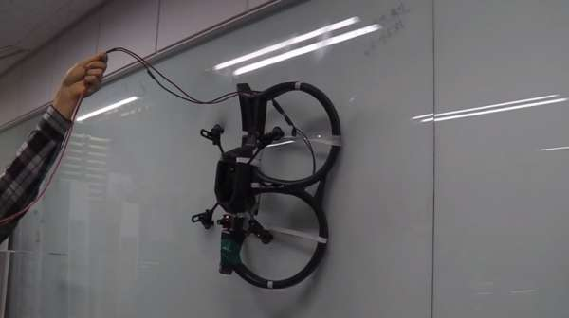
There’s a reason it’s Spider-Man and not Superman who climbs up the walls of buildings: Superman can fly instead. But the KAIST Urban Robotics Lab in South Korea wants to turn flying quadcopters into wall-crawling robots that could wash windows and inspect infrastructure. The result is kind of awkward.
While dedicated wall-climbing robots may do the actual climbing better, there’s one major advantage flying machines have when it comes to working on the outside of a building: when a drone falls, it can usually catch itself in mid-air and fly back to where it belongs. Say the researchers: “The wall-climbing robot can stabilize its position even if it is suddenly detached from the wall by unexpected disturbances, using the flying capability. It makes the maneuverability and safety of the robot improved.”

